Slide 1
Water PumpS!
To fix or Not to Fix..
Zarni

Slide 2
Content
Previously..
Some Screwy Model → Class Imbalance
A less Screwy one
To Regularize
So I can understand → Decision Trees
Playing around with Features
Trying the Model Again and OOOOPS

Slide 3
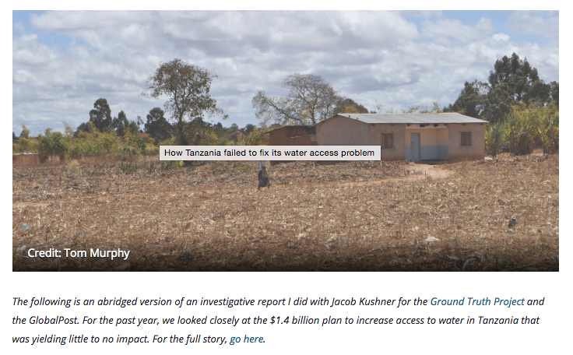
In TanZaNia
Notes:
So the project is on figuring out which water pumps are functional, needs repair or not.. to give more context, the world bank and international organizations have spent quite a lot of money trying to fix this problem.

Slide 4
A reminder of Some Features
amount of water at the water pump
managed by government, private operator, school board etc
different regions
different water pump types
different ways to get water out
public meetings to manage the water pump?
source of water (lake, stream, from the ground)

Slide 5
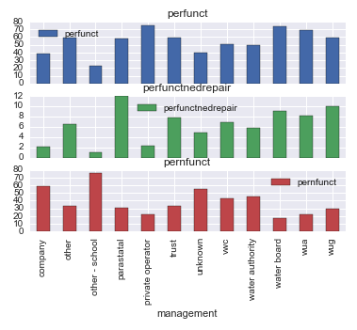
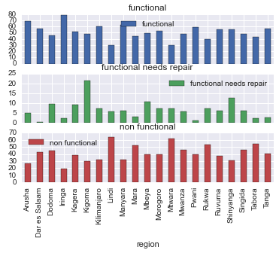
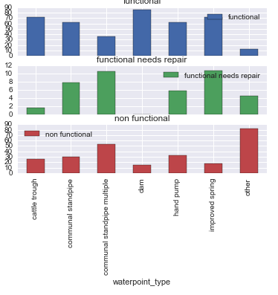
Previously...

Slide 6
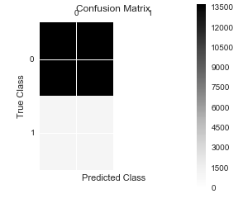

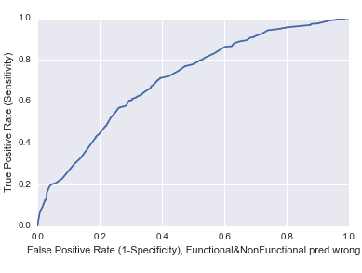
Here Comes SCREWY
 | Screwy | Less Screwy
Accuracy | 92.8
Sensitivity | 0.0
AUC | 70 ish

Slide 7
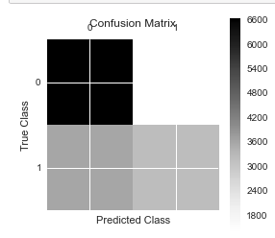
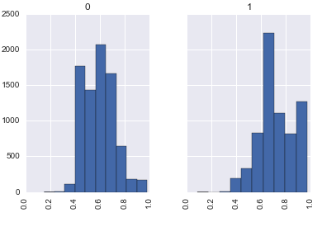
Somewhat Better
Screwy
Less Screwy
Accuracy
92.8
Sensitivity
0.0
AUC
70 ish
 | Screwy | Less Screwy
Accuracy | 92.8 | 66.31
Sensitivity | 0.0 | 46
AUC | 70 ish | 70.2

Slide 8
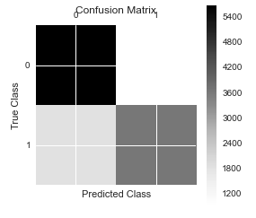
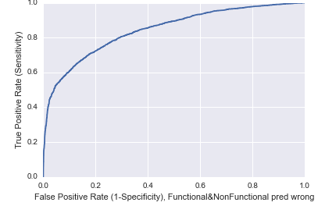
Regularization or dummying..tons
 | Less Screwy | Regularization | TunedReg
Accuracy | 66.31 | 77.178 | 77.195
Sensitivity | 46 | 66.55 | 66.51
AUC | 70.2 | 84.5 | 85.025

Slide 9
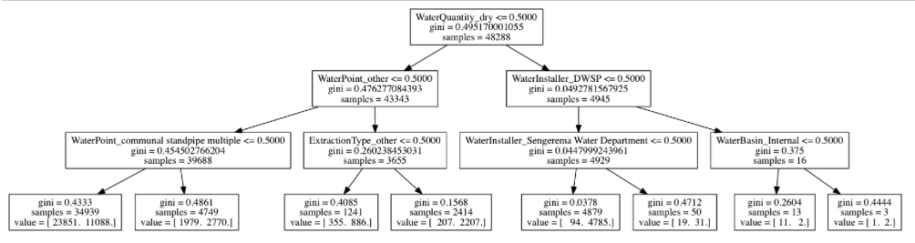
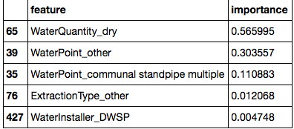
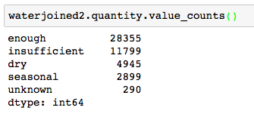
Decision Trees
Regularization | Decision Tree
77.178 | 70.8
66.55
84.5 | 71

Slide 10
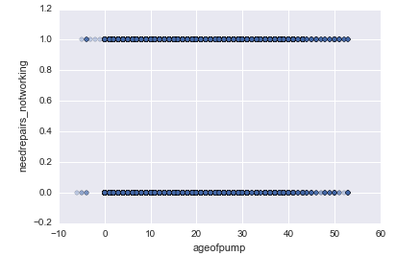
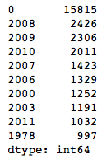
Age of Water PUMP

Slide 11
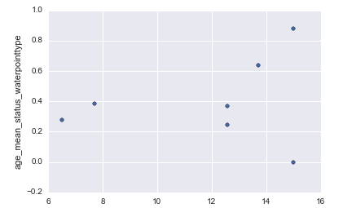
Let’s TRy Another Way

Slide 12
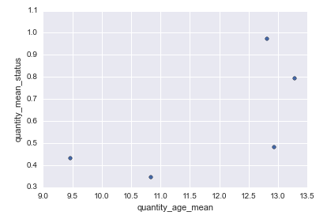
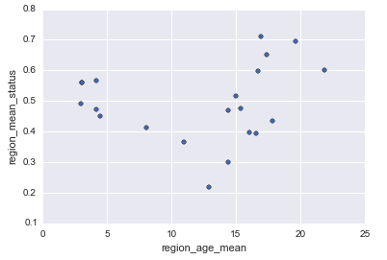
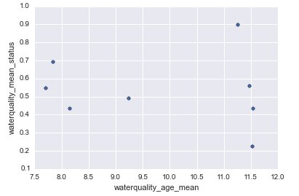
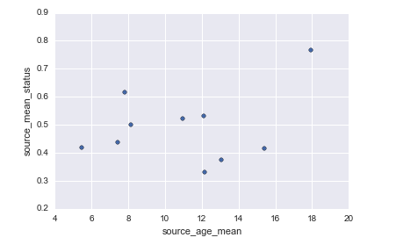
Try again and again and again and give up

Slide 13
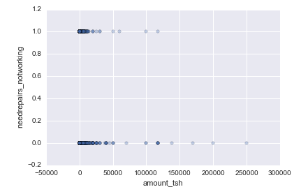
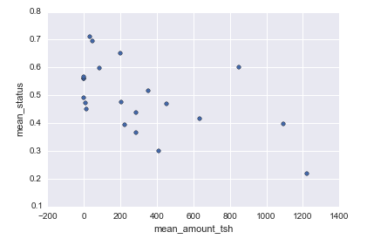
ANother FEATURE

Slide 14
Final Results :( :( :(
 | Regularization | Tuned | Decision Tree | Feature-Engineering
Accuracy | 77.178 | 77.195 | 70.8 | 77.1
Sensitivity | 66.55 | 66.51 |  | 66.5
AUC | 84.5 | 85.025 | 71 | 84.46

Slide 15
Conclusions
Work with Victor O more
More Feature Engineering such as population density, better handle on Constructed Years
Explore other models such as Random Forest
Regularization Coefficients
Decision Tree depth exploration….

